Slide 1

Communication-Computation Trade-off In Resource-Constrained Edge Inference
201911080 손성민

Slide 2
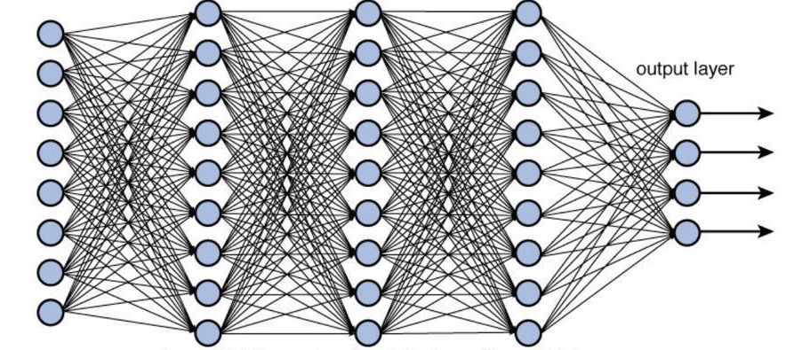
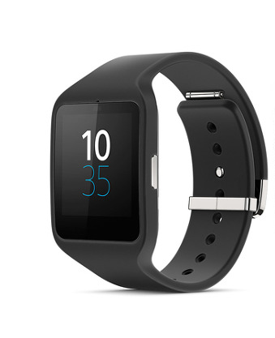
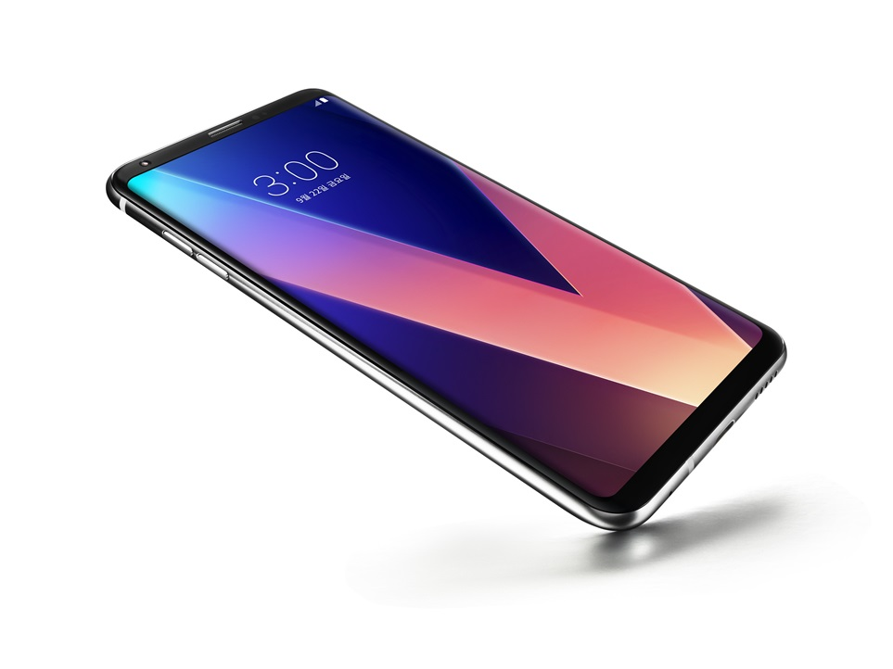
Deep Neural Networks
Edge AI

Slide 3
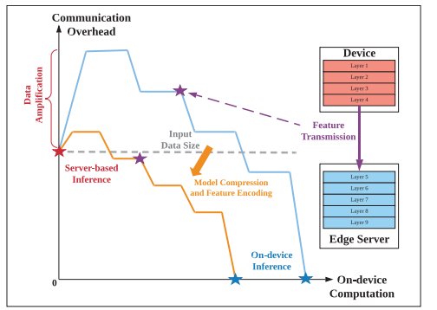





on-device inference
Server-based inference

Slide 5
Communication-Aware
Model Compression
Task-Oriented
Feature Encoding

Slide 6
Model Compression
parameter pruning
low-rank factorization
compact convolutional filters
knowledge distillation
Parameter matrix x and feature matrix B , $X={AB}^{T}$
In CNNs, strong transform constraints filters
Training models by teacher models , tasks with the Softmax loss function

Slide 7


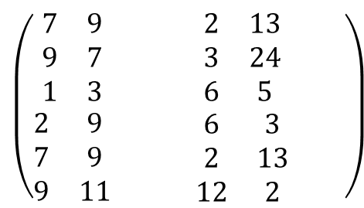
Original
Unstructured purning
Structured purning
$$\left(\begin{matrix}\begin{matrix}7 & 9 & 1 \\ 9 & 7 & 5 \\ 1 & 3 & 5\end{matrix} & \begin{matrix}2 & 13 & 2 \\ 3 & 24 & 1 \\ 6 & 5 & 7\end{matrix} \\ \begin{matrix}2 & 9 & 4 \\ 7 & 9 & 1 \\ 9 & 11 & 7\end{matrix} & \begin{matrix}6 & 3 & 4 \\ 2 & 13 & 2 \\ 12 & 2 & 1\end{matrix}\end{matrix}\right)$$
$$\left(\begin{matrix}\begin{matrix}7 & 9 & 0 \\ 9 & 7 & 5 \\ 0 & 0 & 5\end{matrix} & \begin{matrix}0 & 13 & 0 \\ 3 & 24 & 0 \\ 6 & 5 & 7\end{matrix} \\ \begin{matrix}0 & 9 & 0 \\ 7 & 9 & 1 \\ 9 & 11 & 7\end{matrix} & \begin{matrix}6 & 0 & 0 \\ 2 & 13 & 2 \\ 12 & 0 & 0\end{matrix}\end{matrix}\right)$$
$$\left(\begin{matrix}\begin{matrix}7 & 9 & \\ 9 & 7 & \\ 1 & 3 & \end{matrix} & \begin{matrix}2 & 13 & \\ 3 & 24 & \\ 6 & 5 & \end{matrix} \\ \begin{matrix}2 & 9 & \\ 7 & 9 & \\ 9 & 11 & \end{matrix} & \begin{matrix}6 & 3 & \\ 2 & 13 & \\ 12 & 2 & \end{matrix}\end{matrix}\right)$$

Slide 8
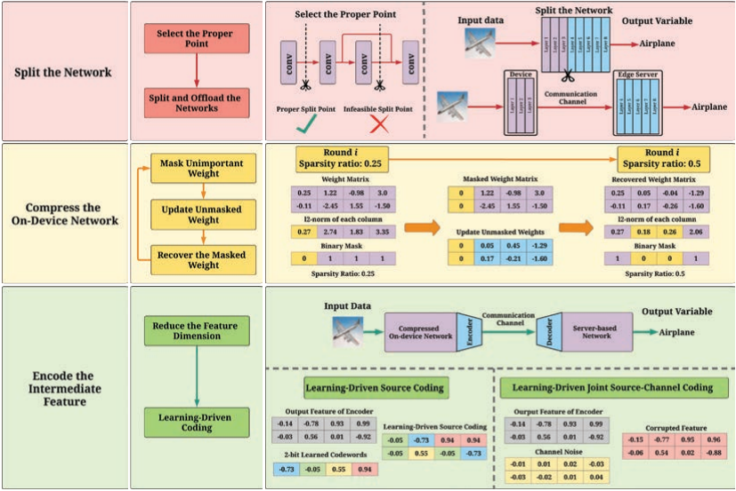
Incremental Network Pruning

Slide 9



Communication-Oriented Encoding
Huffman coding
Task-Oriented Encoding
.PNG
.JPEG
Two-Step
Feature Encoding

Slide 10
Two-Step Feature Encoding

Slide 11
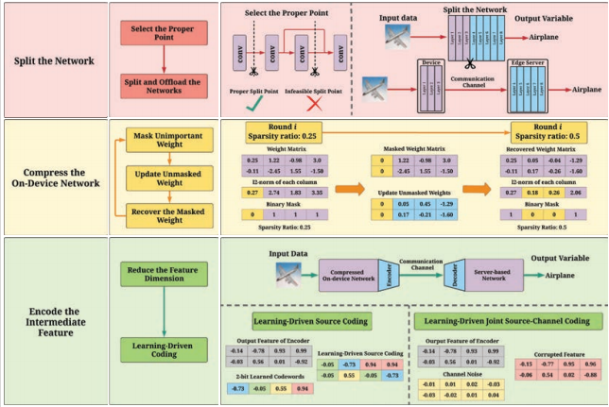
Framework

Slide 12
Experimental Setup
Dataset: 10class, 32x32 size color images, 60,000 (for training:50,000 / for test:10,000)
Neural Network: ResNet18
Metric: accuracy threshold in edge inference – 93%
end-to-end latency
on-device computation workload - approximated by FLOPs
communication overhead - transmitted data size (bits) or transmitted latency (seconds)
Baselines: The original network with split point selection
2-Step Pruning method
BottleNet++ (autoencoder structure to compress the intermediate data)
Huffman coding is used in the original network and the 2-Step Pruning method

Slide 13
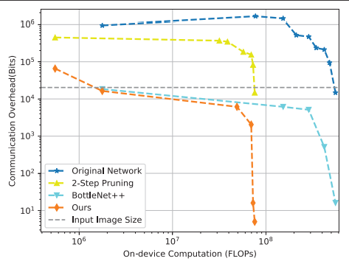
Communication-Computation Trade-off

Slide 14
Edge Inference Speedup
For compare end-to end latency
edge device : Raspberry Pi 3 (1GB RAM, 24GB FLOP/s)
edge server : RTX 2080Ti (11GB RAM ,13.45 TFOLP/s)
The Raspberry is constrained by its memory resource because its CPU and GPU share the 1 GB RAM, and other modules also occupy the memory. We use Pytorch to build the ResNet18, and the original network needs more than 0.9 GB memory.

Slide 15
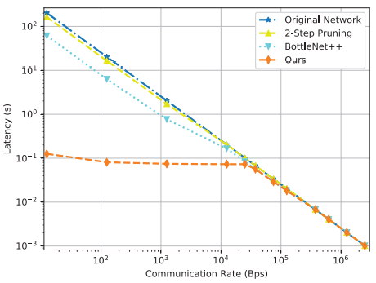
Latency - Communication Rate.

Slide 16
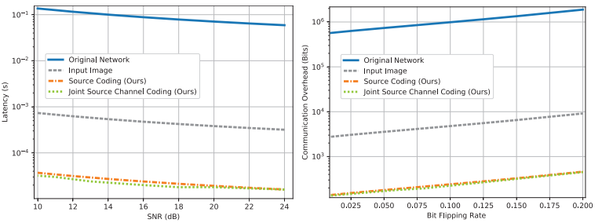
Performance of Learning-Driven JSCC over Noisy Channels

Slide 17
Conclusion & Future Work
brute force search
Time consuming
requires manual setup
many iterations
Hyperparameters
are manually tuned
potential performance loss
additional computational cost

